Slide 1

NEURAL REFINERY
SPRING 2023

Slide 2

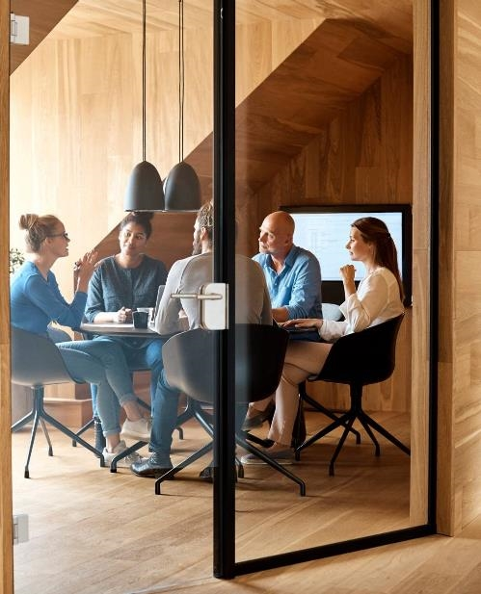

Our Story
We are an international team of freelance developers with our base in Stockholm, Sweden, Our goal is to create and deliver high-quality software and services at a highly competitive price.

Slide 3

Our Skills
Devops AND SOLUTION ARCHITECTURE
  SEO
  FRONTEND
    WEB: HTML5, CSS, JS, AJAX, BOOTSTRAP, REACT, VUEJS
  BACKEND
    LANGUAGE: PHP, PYTHON, NODEJS
    FRAMEWORK: LARAVEL, YII2, CODEIGNITER, DJANGO,REACT
    APPLICATION: ANDROID, REACT NATIVE, JAVA, iOS, SWIFT, XCODE
  DATABASE MANAGEMENT AND ADMINISTRATION
    MySQL, SQL SERVER, ORACLE, PostgreSQL
CLOUD services
  AWS
DATA ANALYTICS
  Visualization
  Modeling
  Video Analytics
SEO & CONTENT CREATION
FINANCIAL SERVICES
  Financial Bot
  Could Base Bot
  Strategy Development
  Risk Management Strategy
Our team has expertise in different development fields ranging from Web and App development to data analysis Machine Learning and Financial Services.

Slide 4



BACKEND & FRONEND

Slide 5
BACKEND & FRONEND | Team & Sample Project
Payamn Vaghefi
Leader
the development of the web sites the platform/software(platform, backend, frontend, and embedded) required for its deployment.
KISH MARATON
url :
Php
Sahbaz Sanat
url:
WordPress
Vira petrol
url:
Python
React js
HTML, Bootstrap

Slide 6
DATA ANALYTICS

Slide 7
Data Analytics | Team & Sample Project
Heidar Maboudi, PhD
Leader
With a PhD. in Machine Learning, Heydar has extensive hands-on experience in the development of Machine Learning and Video Analytics within commercial settings which includes the development of the Machine Learning solution and the platform/software(platform, backend, frontend, and embedded) required for its deployment.

Slide 8


Our Goal
With PowerPoint, you can create presentations and share your work with others, wherever they are. Type the text you want here to get started. You can also add images, art, and videos on this template. Save to OneDrive and access your presentations from your computer, tablet, or phone.

